Slide 1
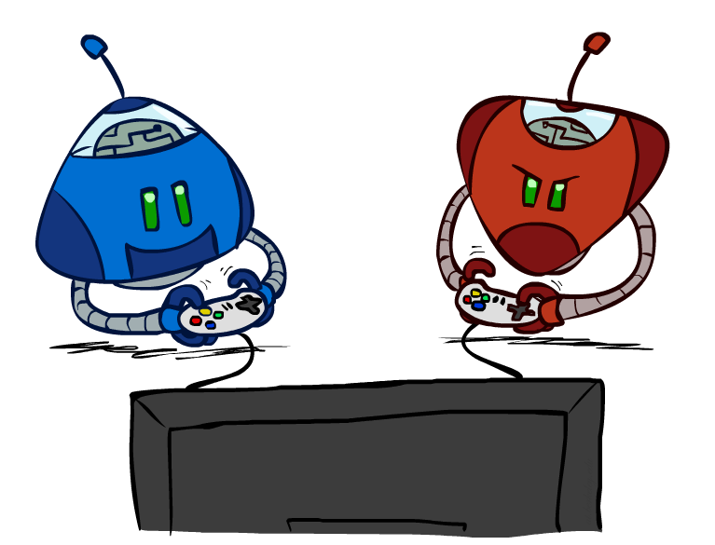
CS 188: Artificial Intelligence
Adversarial Search and Game Trees
Instructor: Imtiaz Parvez
Utah Valley University
[Slides adapted from George Rudolph, Dan Klein and Pieter Abbeel (ai.berkeley.edu).]
Notes:
Please retain proper attribution, including the reference to ai.berkeley.edu. Thanks!

Slide 2
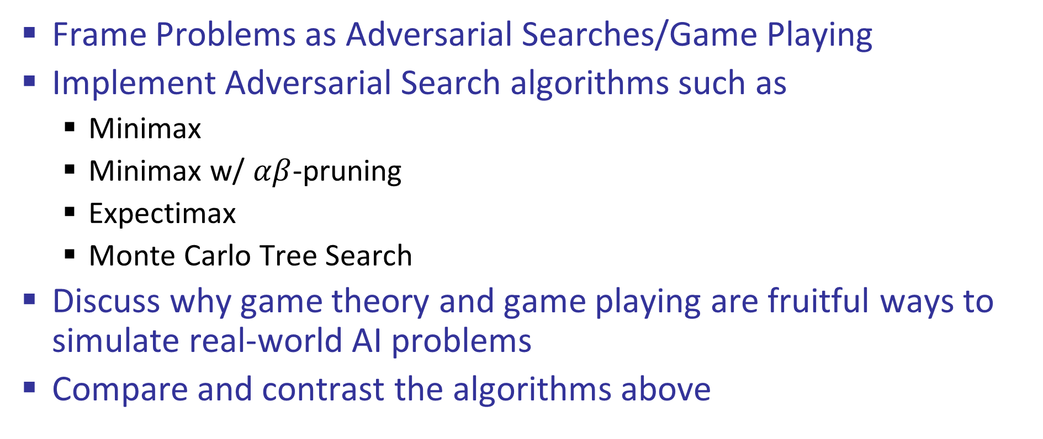
Learning Outcomes
Frame Problems as Adversarial Searches/Game Playing
Implement Adversarial Search algorithms such as
Minimax
Minimax w/ $αβ$-pruning
Expectimax
Monte Carlo Tree Search
Discuss why game theory and game playing are fruitful ways to simulate real-world AI problems
Compare and contrast the algorithms above

Slide 3
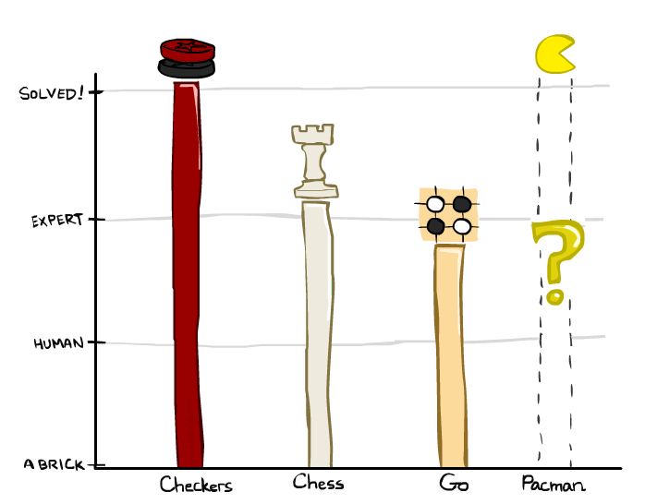
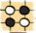
A brief history
Checkers:
1950: First computer player.
1959: Samuel’s self-taught program.
1994: First computer world champion: Chinook defeats Tinsley
2007: Checkers solved! Endgame database of 39 trillion states
Chess:
1945-1960: Zuse, Wiener, Shannon, Turing, Newell & Simon, McCarthy.
1960s onward: gradual improvement under “standard model”
1997: Deep Blue defeats human champion Gary Kasparov
2021: Stockfish rating 3551 (vs 2870 for Magnus Carlsen).
Go:
1968: Zobrist’s program plays legal Go, barely (b>300!)
1968-2005: various ad hoc approaches tried, novice level
2005-2014: Monte Carlo tree search -> strong amateur
2016-2017: AlphaGo defeats human world champions
Pacman
Notes:
Tinsley lost only 5 games to humans in 42 years; has been known to solve 60-ply problems

Slide 4
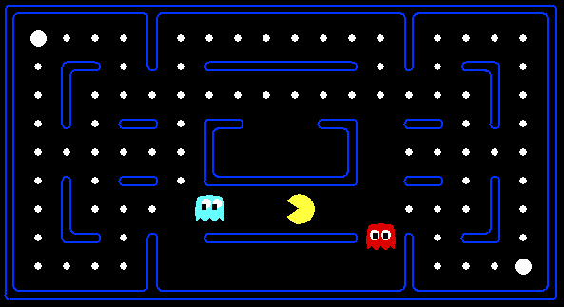
Behavior from Computation

Slide 5

Video of Demo Mystery Pacman

Slide 6
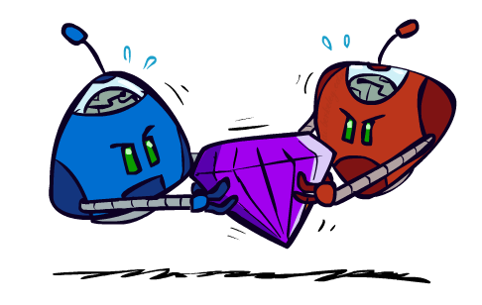
Adversarial Games

Slide 7
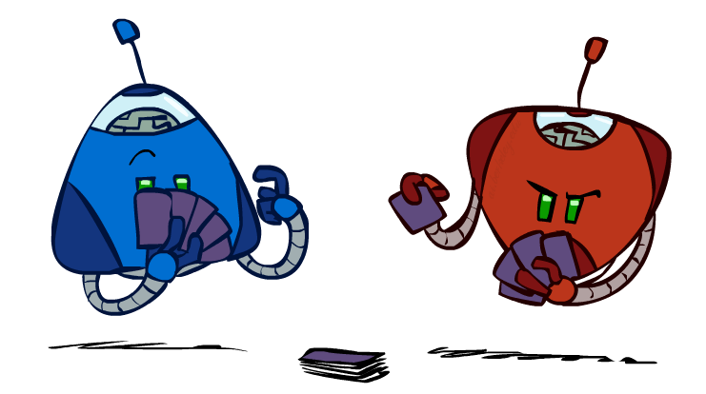
Types of Games
Many different kinds of games!
Axes:
Deterministic or stochastic?
One, two, or more players?
Zero sum?
Perfect information (can you see the state)?
Want algorithms for calculating a strategy (policy) which recommends a move from each state

Slide 8
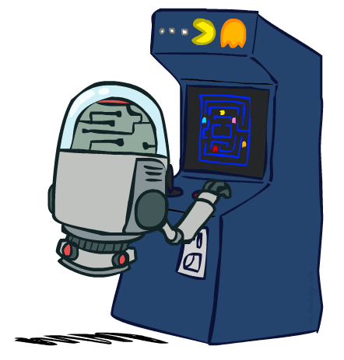
Deterministic Games
Many possible formalizations, one is:
States: S (start at s₀)
Players: P={1...N} (usually take turns)
Actions: A (may depend on player / state)
Transition Function: SxA → S
Terminal Test: S → {t,f}
Terminal Utilities: SxP → R
Solution for a player is a policy: S → A

Slide 9
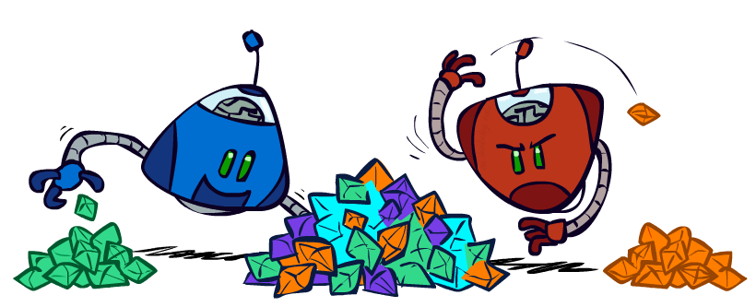
Zero-Sum Games
Zero-Sum Games
Agents have opposite utilities (values on outcomes)
Lets us think of a single value that one maximizes and the other minimizes
Adversarial, pure competition
General Games
Agents have independent utilities (values on outcomes)
Cooperation, indifference, competition, and more are all possible
More later on non-zero-sum games

Slide 10

Adversarial Search

Slide 11
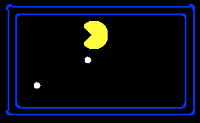
Single-Agent Trees
8
2
0
…
2
6
…
4
6

Slide 12
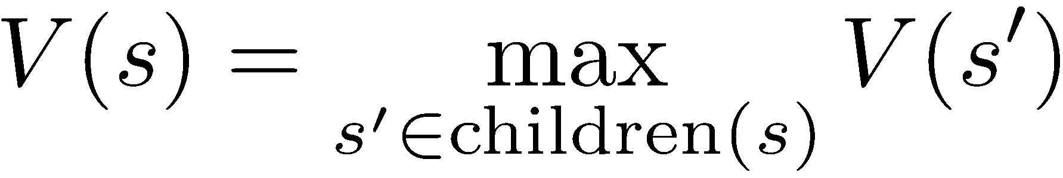
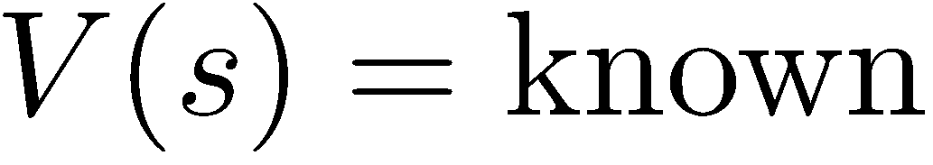
Value of a State
Value of a state: The best achievable outcome (utility) from that state
Non-Terminal States:
8
2
0
…
2
6
…
4
6
Terminal States:

Slide 13

Adversarial Game Trees
-20
-8
…
-18
-5
…
-10
+4
-20
+8

Slide 14
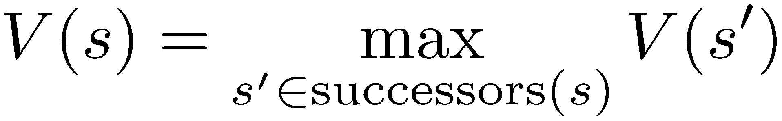
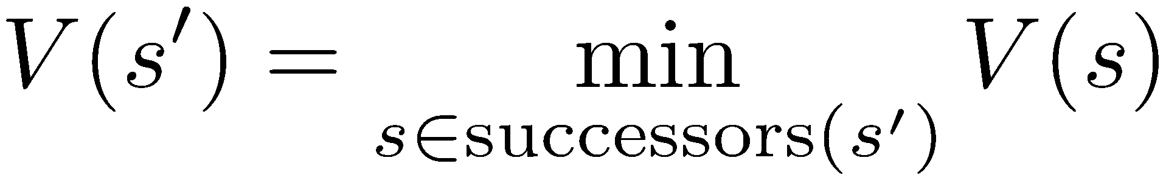
Minimax Values
States Under Agent’s Control:
States Under Opponent’s Control:
-8
-5
-10
+8
Terminal States:

Slide 15

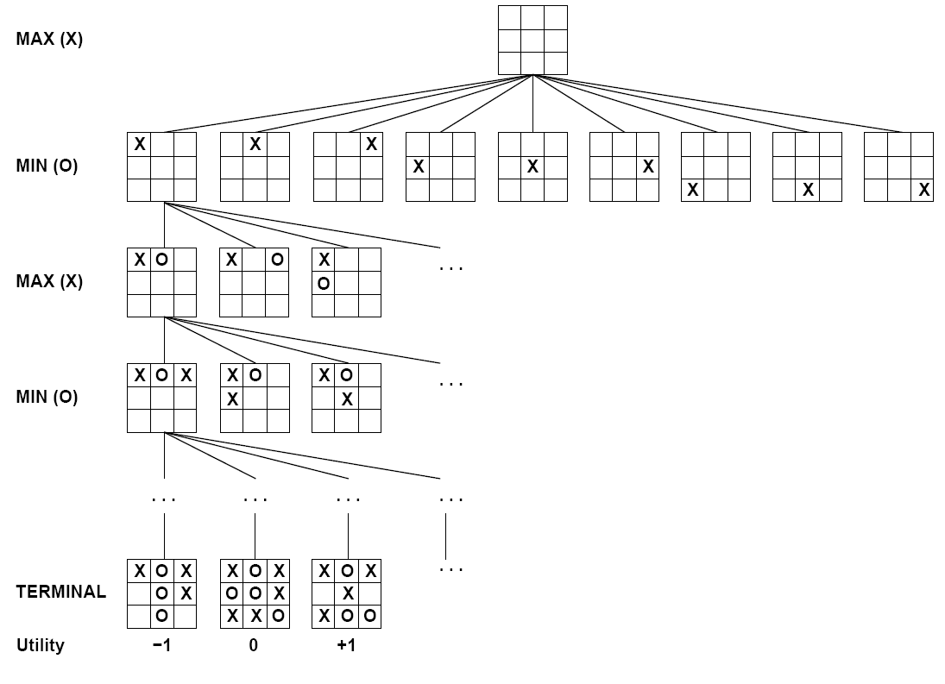

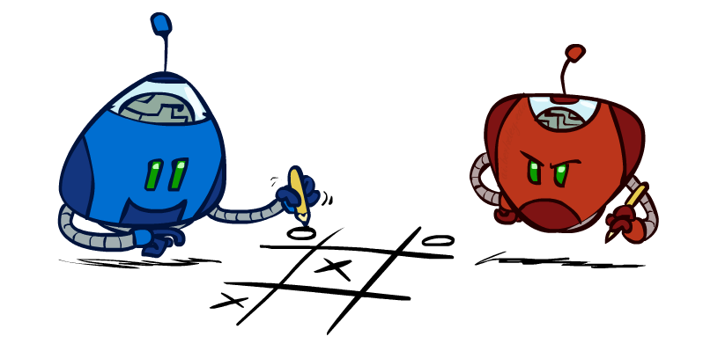
Tic-Tac-Toe Game Tree

Slide 16
Adversarial Search w/ Minimax
Deterministic, zero-sum games:
Tic-tac-toe, chess, checkers
One player maximizes result
The other minimizes result
Minimax search:
A state-space search tree
Players alternate turns
Compute each node’s minimax value: the best achievable utility against a rational (optimal) adversary
Minimax values: computed recursively
5
max
2
5
min
8
2
5
6
Terminal values for max: part of the game

Slide 17
Minimax Implementation
def max-value(state):
initialize v = -∞
for each successor of state:
v = max(v, min-value(successor))
return v
def min-value(state):
initialize v = +∞
for each successor of state:
v = min(v, max-value(successor))
return v

Slide 18
Minimax Implementation (Dispatch)
def value(state):
if the state is a terminal state: return the state’s utility
if the next agent is MAX: return max-value(state)
if the next agent is MIN: return min-value(state)
def max-value(state):
initialize v = -∞
for each successor of state:
v = max(v, value(successor))
return v
def min-value(state):
initialize v = +∞
for each successor of state:
v = min(v, value(successor))
return v

Slide 19
Minimax Example
3
12
8
2
4
6
14
5
2

Slide 20
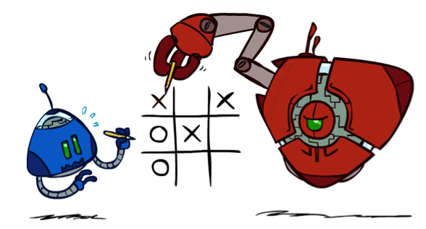
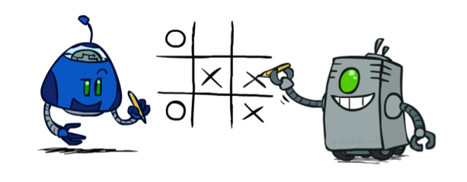
Minimax Properties
max
min
10
10
9
100
Optimal against a perfect player. Otherwise?

Slide 21
Video of Demo Min vs. Exp (Min)

Slide 22
Video of Demo Min vs. Exp (Exp)

Slide 23
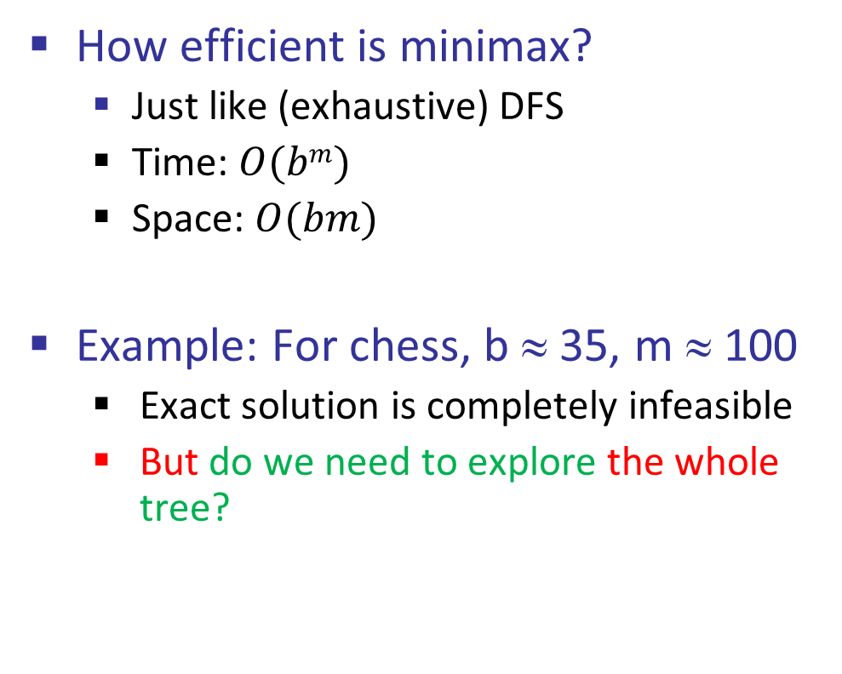
Minimax Efficiency
How efficient is minimax?
Just like (exhaustive) DFS
Time: $O(bm)$
Space: $O(bm)$
Example: For chess, b ≈ 35, m ≈ 100
Exact solution is completely infeasible
But do we need to explore the whole tree?

Slide 24

Resource Limits

Slide 25
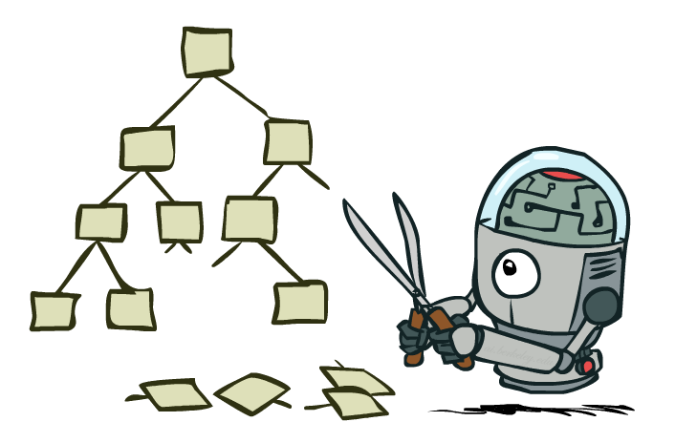
Game Tree Pruning

Slide 26
Minimax Example
3
12
8
2
4
6
14
5
2

Slide 27

Minimax Pruning
3
12
8
2
14
5
2

Slide 28

$αβ$-Pruning
General configuration (MIN version)
We’re computing the MIN-VALUE at some node n
We’re looping over n’s children
n’s estimate of the childrens’ min is dropping
Who cares about n’s value? MAX
Let a be the best value that MAX can get at any choice point along the current path from the root
If n becomes worse than a, MAX will avoid it, so we can stop considering n’s other children (it’s already bad enough that it won’t be played)
MAX version is symmetric
MAX
MIN
a
MAX
MIN
n

Slide 29
Alpha-Beta Implementation
α: MAX’s best option on path to root
β: MIN’s best option on path to root
def max-value(state, α, β):
initialize v = -∞
for each successor of state:
v = max(v, value(successor, α, β))
if v ≥ β return v
α = max(α, v)
return v
def min-value(state, α, β):
initialize v = +∞
for each successor of state:
v = min(v, value(successor, α, β))
if v ≤ α return v
β = min(β, v)
return v

Slide 30
Alpha-Beta Pruning Properties
This pruning has no effect on minimax value computed for the root!
Values of intermediate nodes might be wrong
Important: children of the root may have the wrong value
So the most naïve version won’t let you do action selection
Good child ordering improves effectiveness of pruning
With “perfect ordering”:
Time complexity drops to O(b^m/2)
Doubles solvable depth!
Full search of games like chess is still hopeless…
Simple example of metareasoning
computing about what to compute
max
min
10
10
0

Slide 31
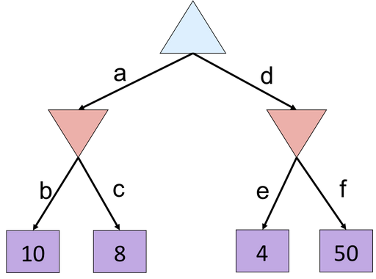


Alpha-Beta Quiz

Slide 32
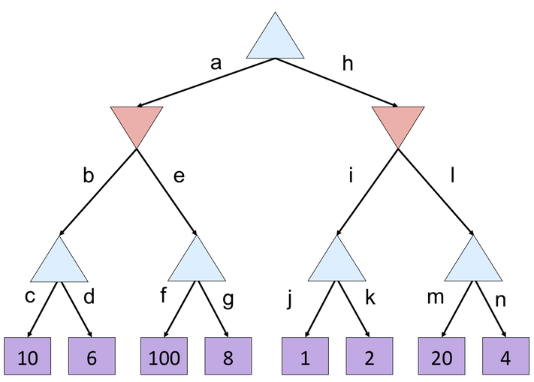

Alpha-Beta Quiz 2

Slide 33
Resource Limits

Slide 34
Resource Limits
Problem: In realistic games, cannot search to leaves!
Solution: Depth-limited search
Instead, search only to a limited depth in the tree
Replace terminal utilities with an evaluation function for non-terminal positions
Example:
Suppose we have 100 seconds, can explore 10K nodes / sec
So can check 1M nodes per move
α-β reaches about depth 8 – decent chess program
Guarantee of optimal play is gone
More plies makes a BIG difference
Use iterative deepening for an anytime algorithm
4
max
-2
4
min
-1
-2
4
9
?
?
?
?

Slide 35
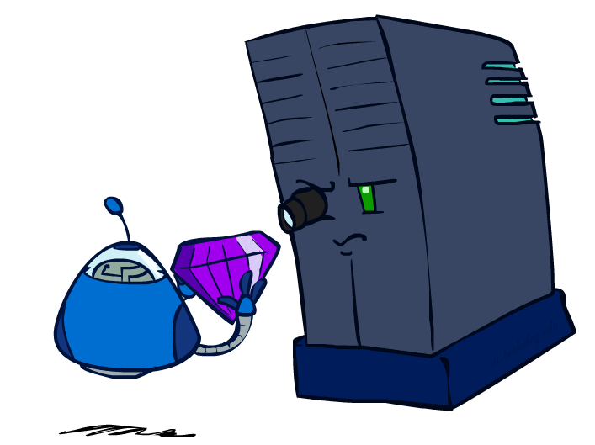
Evaluation Functions

Slide 36
Evaluation Functions
Evaluation functions score non-terminals in depth-limited search
Ideal function: returns the actual minimax value of the position
In practice: typically weighted linear sum of features:
e.g. f₁(s) = (num white queens – num black queens), etc.

Slide 37




Evaluation for Pacman

Slide 38
Video of Demo Smart Ghosts (Coordination)

Slide 39
Video of Demo Smart Ghosts (Coordination) – Zoomed In

Slide 40
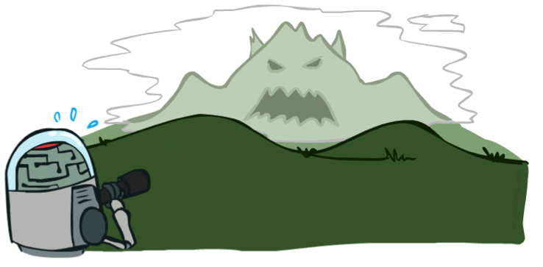

Depth Matters
Evaluation functions are always imperfect
The deeper in the tree the evaluation function is buried, the less the quality of the evaluation function matters
An important example of the tradeoff between complexity of features and complexity of computation

Slide 41
Video of Demo Limited Depth (2)

Slide 42
Video of Demo Limited Depth (10)

Slide 43
Synergies between Evaluation Function and Alpha-Beta?
Alpha-Beta: amount of pruning depends on expansion ordering
Evaluation function can provide guidance to expand most promising nodes first
Later-on: more likely there is already a good alternative on the path to the root
like role of A* heuristic
Alpha-Beta:
Value at a min-node will only keep going down
Once value of min-node lower than better option for max along path to root, can prune
Hence: IF evaluation function provides upper-bound on value at min-node, and upper-bound already lower than better option for max along path to root THEN can prune
Similar if min-max roles are switched

Slide 44
Summary
Games (economies) require decisions when optimality is impossible
Bounded-depth search and approximate evaluation functions
Games force efficient use of computation
Alpha-beta pruning
Game playing has produced important research ideas
Reinforcement learning (checkers)
Iterative deepening (chess)
Rational metareasoning (Othello)
Monte Carlo tree search (Go)
Solution methods for partial-information games in economics (poker)
Video games present much greater challenges – lots to do!
b = 10⁵⁰⁰, |S| = 10⁴⁰⁰⁰, m = 10,000

